Slide 1
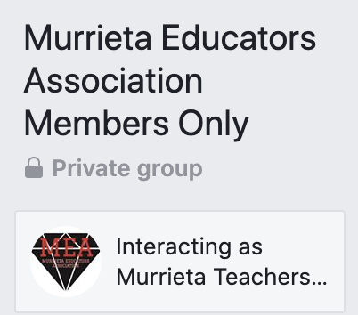
WELCOME TO YOUR UNION!
Three Associations. One Movement.
MEA APP
#WEARECTA
#MEAStrong
www.goMTA.org

Slide 2
The Beginning of Your Professional Journey…
YOUR MEMBERSHIP IS
For nearly 160 years CTA members have advocated for educators and students to ensure every person has access to a free quality public education in California. Our successes include:
1867
1913
1915
1927
Access to public schools for all students
Retirement with dignity
Ending child labor in California
Preventing pregnancy firings

Slide 3
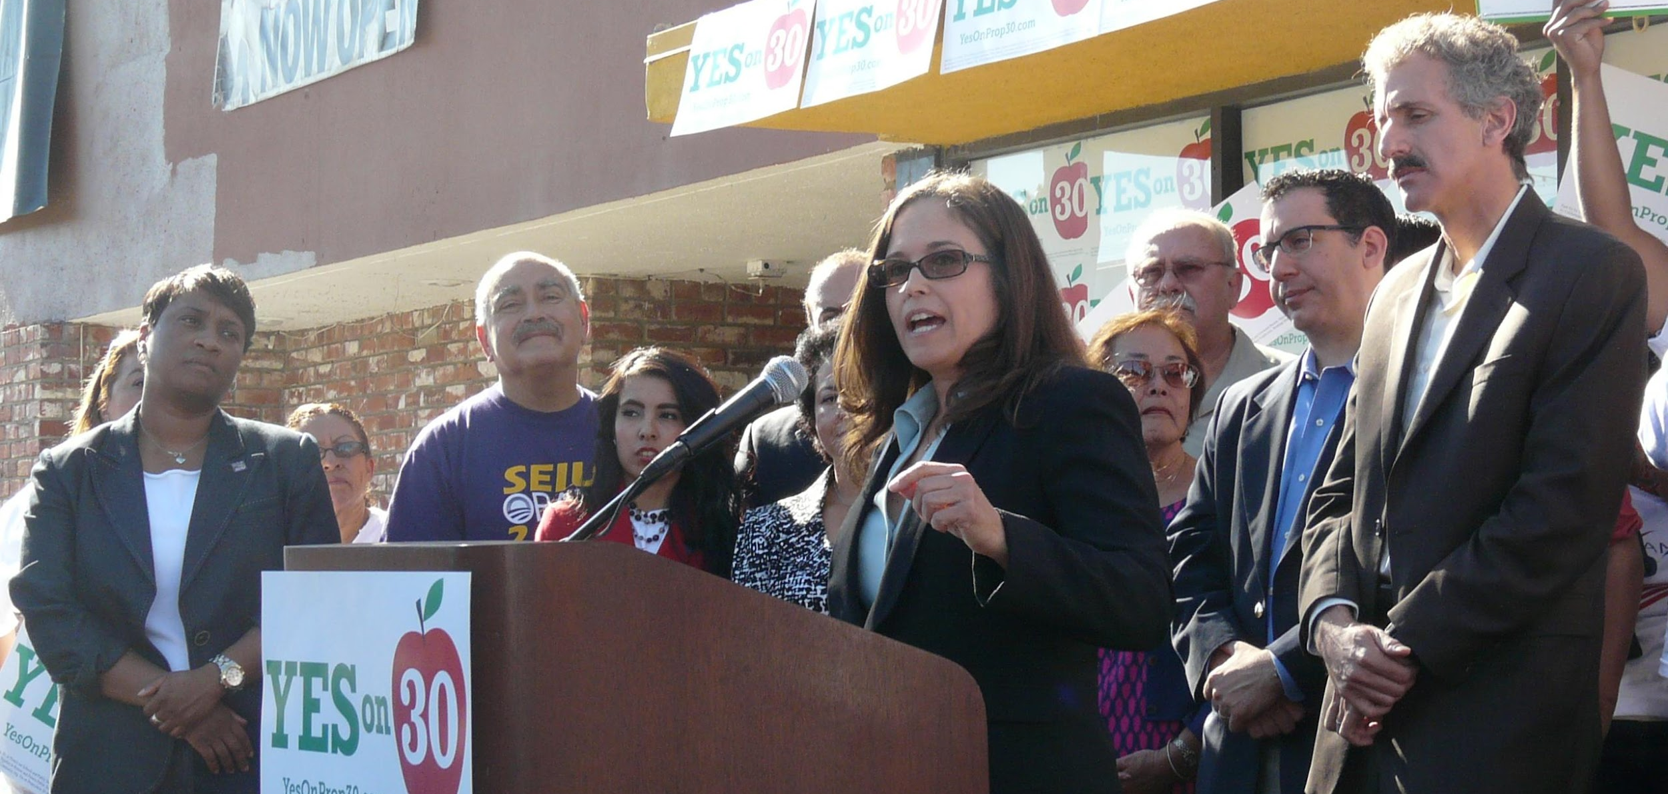
Your Journey Will Become Your Legacy
What part will you play in our progress toward greater equity, access and fairness for all California’s students?!
2012
CTA led the fight to pass the Prop. 30, generating $42 billion for public schools and local services over seven years.
2017
Supporting the nationwide #Red4Ed Movement and the fight for fundamental services for our public schools

Slide 4
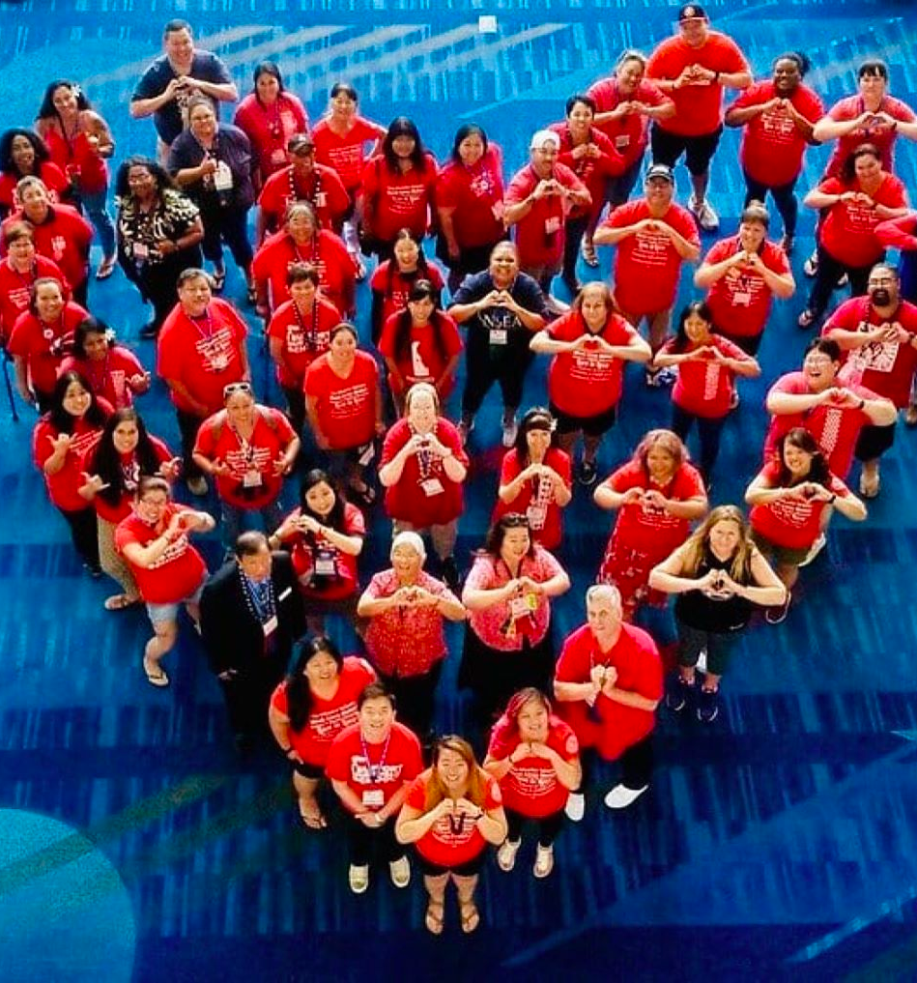
Strengthening Our Collective Power
We believe that highly-skilled professionals should have a voice in their workplace. After all, a good working environment is a good learning environment.
CTA supports your local leaders to negotiate fair wages and healthcare benefits for all members.

Slide 5
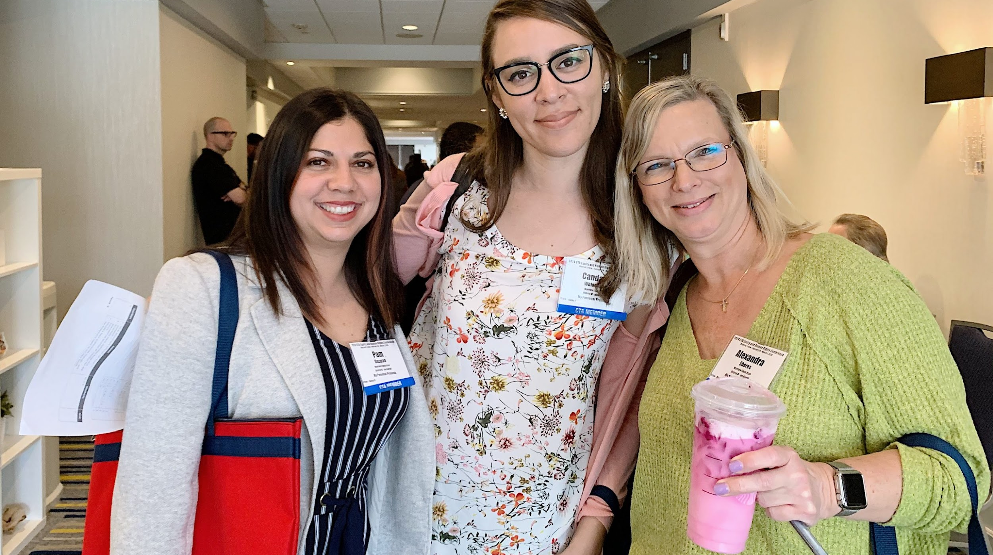
Professional Growth Opportunities
Improve your professional skills at the New Educator Weekends, Good Teaching Conferences, or other conferences offered each year.
And attend one (or many) of CTA’s Professional Development trainings…now virtual. You’ll learn how to connect with your students remotely, brush up on skills for distant teaching, and become a more well-rounded teacher.
www.CTA.org/events

Slide 6
Scholarships & Grants
CTA offers a number of scholarships and awards to educators and members of the community who promote quality public education and impact their students and community.
Through CTA’s Institute for Teaching, we award innovation grants every year to members who need extra money to bring their ideas to life.
www.CTA.org/scholarships

Slide 7
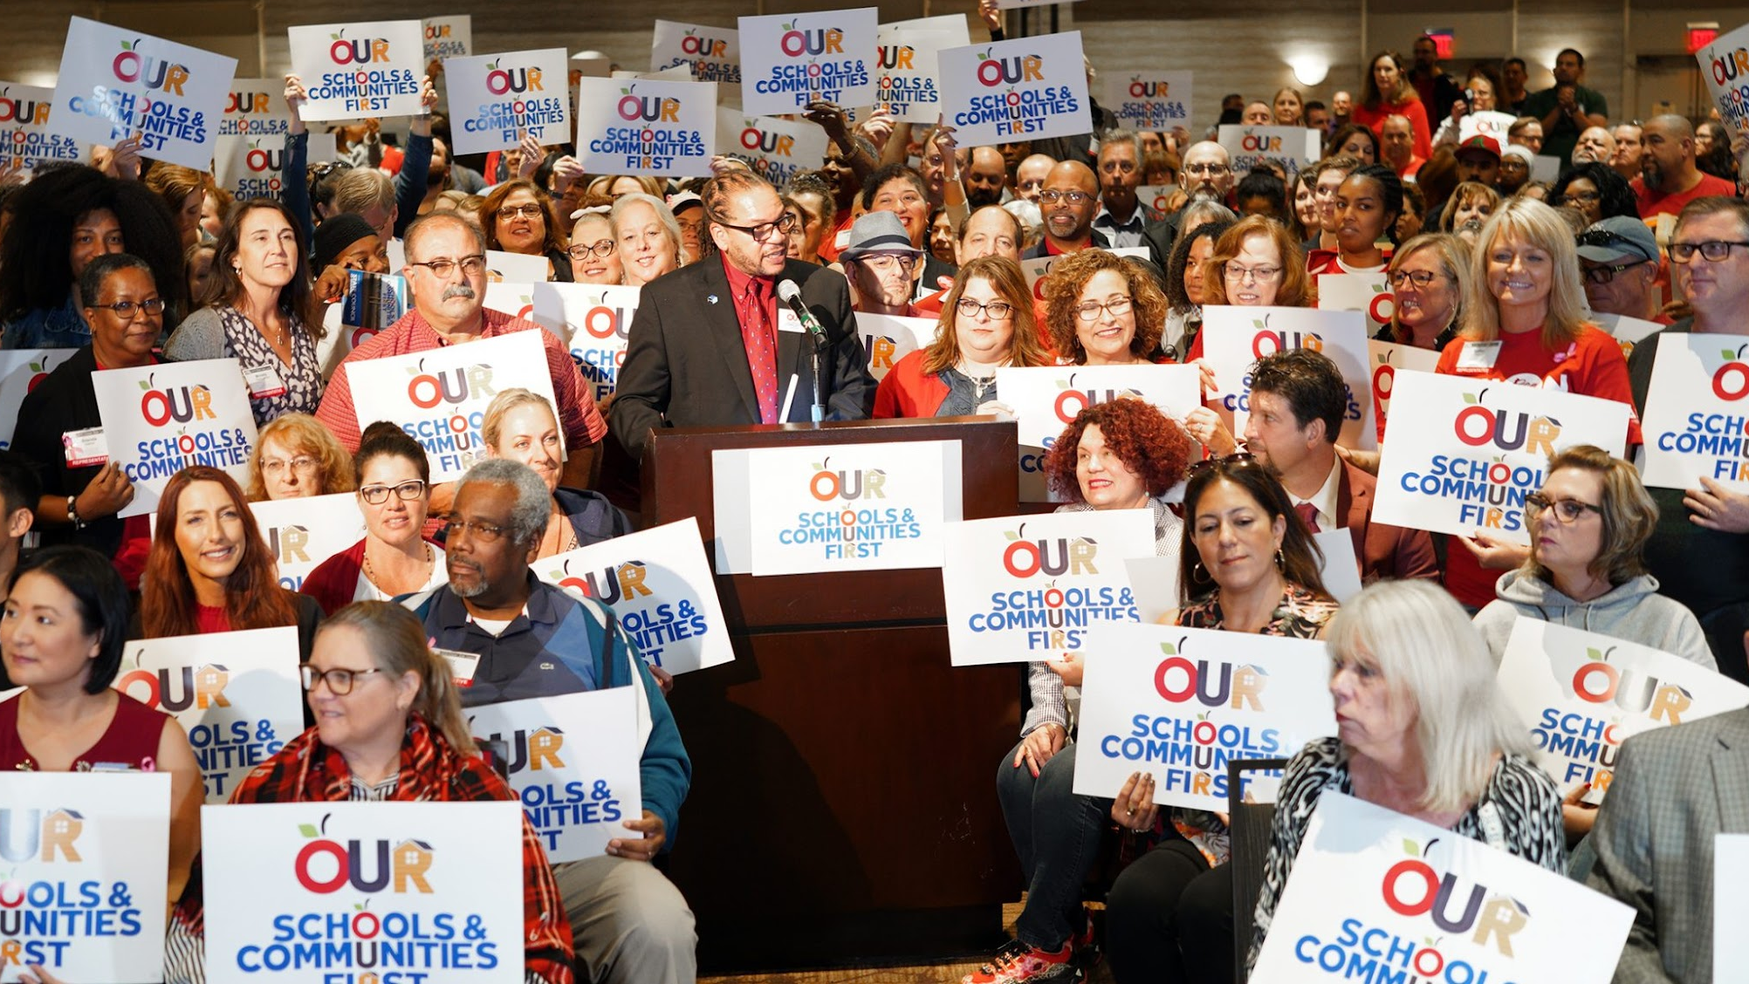
Advocating for You and Your Students
YOUR VOICE ON LOCAL, STATE & NATIONAL
CTA has built a legacy of standing together and working for our members, our students, our craft and the belief that public education is a cornerstone of American democracy. That belief drives our advocacy at the State Capitol and our nation’s Capitol, as well as our local school board meetings.
And, in the event that you need us, you’ve got a legal advocate to represent you on work-related issues.

Slide 8
CTA Access to Savings
CTA Access to Savings, for members only, features the nation’s largest private discount network.
Find savings up to 50% on travel, entertainment, along with everyday things like food, clothing, car care, even home and garden supplies. In fact, use the program regularly and you could save enough to offset the entire cost of your dues!
www.ctaMemberBenefits.org

Slide 9
Healthcare, Insurance and Long-Term Savings
While your local chapter negotiates salary and healthcare, your membership is your gateway to savings on discounted auto, home, and insurance programs. Loans for autos, personal- even home loans are available. Retirement planning should begin as soon as possible. Calculators and tools can assist you whatever your age.
www.ctaMemberBenefits.org
www.ctaInvest.org

Slide 10
Murrieta Educators Association worked to improve the conditions of teaching and learning in your school.
Negotiated distance learning working conditions in Spring of 2020 through 2021.
Sent more than 30 members to conferences & workshops last year.
Provided more than 20 member scholarships for continuing education credit.
Our committees are continuing to grow and thrive. There is a committee for a broad range of activities and interest.

Slide 11
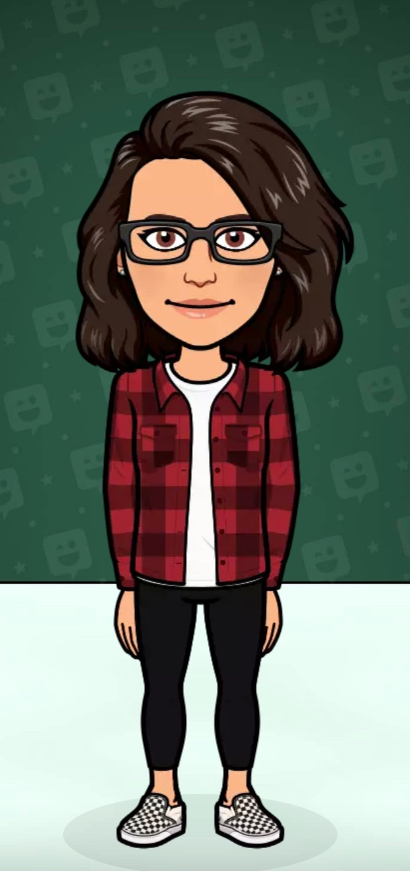
MEA President
Kim Chevlin
Kchevlin@verizon.net
951-303-4527 (cell#)
Secretary/Bargaining Chair
Lisa Murray - DMMS
lisamurray_@msn.com
Treasurer
Lisa Van Ryzin, MSN, R.N.
vanryzin@gmail.com
CTA Primary Contact Staff
Kate Phillips
951-461-2183
Office Manager
Sara Doll
951-304-0528
Lisa Murray
Lisa Van Ryzin,
MSN, RN
Kim Chevlin
Kate Phillips/CTA
Sara Doll

Slide 12
Cynthia Maddox-Sanchez,
SLP
High School Director -
Chris Shoults
Cjshoults@gmail.com
Middle School Director
Julie Pulatie - Warm Springs
japulatie@gmail.com
Elementary Director - Vacant
Election to be held in Fall.
Special Support Services
Cynthia Maddox-Sanchez,
cmsanchezslp@gmail.com
SPED Director –
Heidi Schumaker
hschum3@aol.com
MS Director- Julie Pulatie
HS Director - Chris Shoults
Elementary Director - Vacancy
SPED Director – Heidi Schumaker

Slide 13
Benefits of membership –
Social activities with fellow educators
Continued professional development opportunities
Discounts on travel, home, car, and classroom insurance
Pet insurance
Discounts on rental cars
Investment planning
Legal consultations and support for work related issues
Legal consultations 30 min) for non work related matters

Slide 14
All this for the bargain price of ….
MEA dues - $18.00/$180.00
CTA dues - $73.70/$737.00
NEA dues - $20.00/$200.00
Note – dues are deducted 10 pay periods each year.

Slide 15
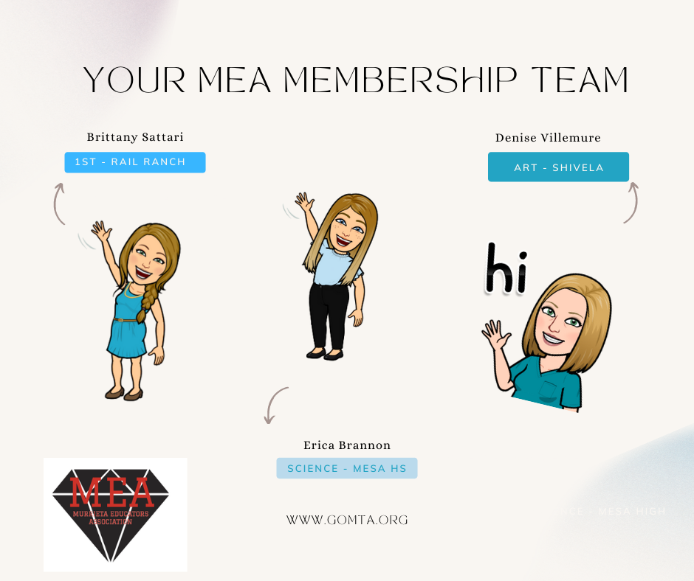
Your Membership Matters
Brittany Sattari – Rail Ranch
brittanysattari@gmail.com
Erica Brannon – Mesa HS
epbrannon@gmail.com
Denise Villemure – Shivela MS
dvillemure3@gmail.com

Slide 16
Did you … change districts? work on a temporary contract for MVUSD last year?
*If you were a member of MEA /CTA last year as a temporary employee at MVUSD or an employee of another district, please note that the membership roll is scrubbed at the end of June’s payroll cycle. You will need to click the link to rejoin or contact Sara Doll @ 951-304-0528/murrietata1@Verizon.net

Slide 17
Videos to Share
CTA/NEA UNION VIDEO (2:29)
CTA/NEA UNION VIDEO (0:30)
CTA WONDERFUL JOB VIDEO (0:31)
CTA ADVOCACY VIDEO (0:31)
MEMBER BENEFITS VIDEO (5:10)

Slide 18
Join Us
You can easily join online today.
cta.org/join
JOIN

